Slide 1

INFOSYS SPRINGBOARD VIRTUAL INTERNSHIP 7.0
CYBER THREAT ANALYTICS PLATFORM
Advanced Threat
Incident Analytics
Framework
Cyber Threat Analytics Platform with Incident Visualization System
Presented by Akshay Jaiswal | Mentor: Mrs. Nithyasri S J

Slide 2
FRAMEWORK / 02
Project Objectives
01
02
03
04
Manual Triage
Mitigation
Clean Data
Engineering
Interactive Visual
Analytics
Containment Gap
Detection
Reduce analyst effort through structured prioritization.
Deduplicate, normalize and validate network telemetry.
Turn incident signals into decision-ready visual stories.
Expose critical threats that remain allowed or unresolved.
ADVANCED THREAT INCIDENT ANALYTICS • 2026
02

Slide 3
FRAMEWORK / 03
Project Description & Modules
Building a cyber threat analytics platform that converts raw network events into correlated incidents, interactive visuals and response-ready intelligence.
01
02
03
Data Ingestion & Cleaning
Threat Detection Logic
Incident Triage Automation
Normalize schema • remove duplicates
Score behavior • flag risk patterns
Correlate events • prioritize queues
04
05
06
Visual Analytics Dashboard
Containment & Response
Reporting & Alerts
Explore trends • drill into incidents
Track actions • reveal control gaps
Share findings • trigger escalation
ADVANCED THREAT INCIDENT ANALYTICS • 2026
03

Slide 4
FRAMEWORK / 04
8-Step Project Workflow
01
02
03
04
05
06
07
08
Data
Collection
Preprocessing
& Cleaning
Threat
Scoring
Incident
Correlation
Triage &
Prioritization
Visuali-
zation
Response
Tracking
Feedback
Loop
ADVANCED THREAT INCIDENT ANALYTICS • 2026
04

Slide 5
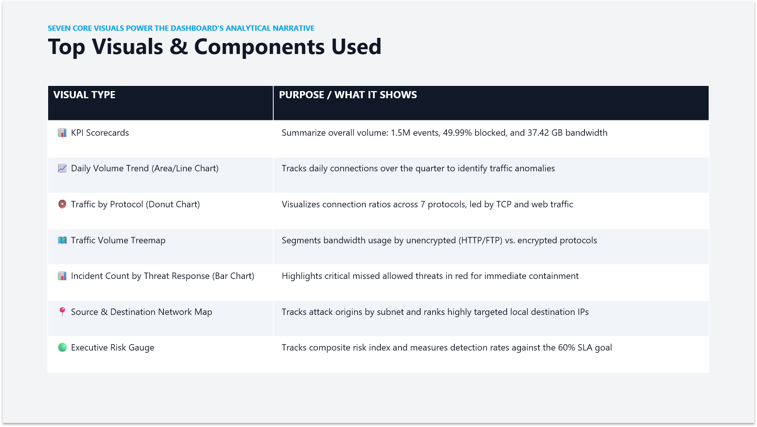
FRAMEWORK / 05
01
02
03
04
KPI Scorecards
Daily Volume Trend
Traffic by Protocol
Traffic Volume Treemap
05
06
07
Incident Count by Response
Source & Destination Map
Executive Risk Gauge
ADVANCED THREAT INCIDENT ANALYTICS • 2026
05

Slide 6
FRAMEWORK / 06
Project Milestones & Timeline
02 JUL
16 JUL
06 AUG
13 AUG
Project Kickoff
Data Engineering
Visualization Deployment
Final Validation
Initial setup and scope alignment
Clean pipeline and model completed
Interactive module released
Testing, review and sign-off
ADVANCED THREAT INCIDENT ANALYTICS • 2026
06

Slide 7
FRAMEWORK / 07
Challenges & Resolutions
CHALLENGE
RESOLUTION
Network retransmission duplicates
Deduplication logic
High-cardinality metadata
Optimized data indexing
Incident triage logic complexity
Layered filtering rules
ADVANCED THREAT INCIDENT ANALYTICS • 2026
07

Slide 8
FRAMEWORK / 08
Learnings & Skills Acquired
DATA
DETECT
VISUAL
RESPOND
TEAM
Data engineering
best practices
Cyber threat detection
methodologies
Power BI dashboard
design & interactivity
Incident triage &
response automation
Collaborative project
management
ADVANCED THREAT INCIDENT ANALYTICS • 2026
08

Slide 9
FRAMEWORK / 09
Future Enhancements & Key Insights
NEXT HORIZON
SIGNALS THAT MATTER
Real-time ingestion via Azure Event Hubs
Geolocation mapping integration
Automated email alert triggers
Machine learning anomaly detection
49.89%
82 / 8,900
critical allowed rate
external / total subnets
9.3 GB
SUBNET 88
TCP data analyzed
primary threat vector
The containment gap is not merely a reporting metric — it is the clearest signal for response prioritization.
ADVANCED THREAT INCIDENT ANALYTICS • 2026
09

Slide 10
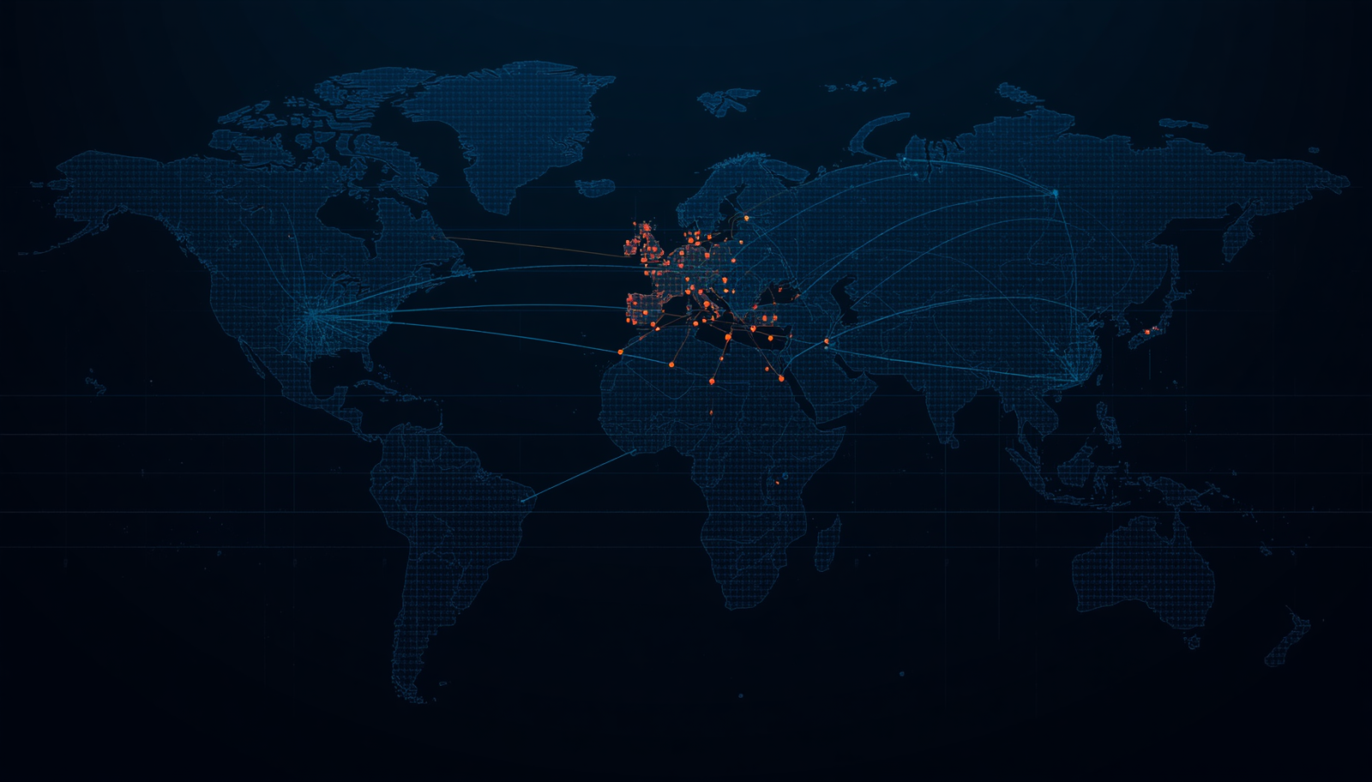
CONCLUSION
Visibility becomes
action when analytics
closes the gap.
The platform unifies interactive visual analytics with containment gap detection — improving threat visibility, triage focus and incident response effectiveness.
ADVANCED THREAT INCIDENT ANALYTICS • 10

Slide 11
FRAMEWORK / 11
Acknowledgements & References
With sincere thanks
Mrs. Nithyasri S J
For mentorship, guidance and thoughtful review — and to the Infosys Springboard team for enabling this internship experience.
INFOSYS SPRINGBOARD POWER BI AZURE EVENT HUBS
SOURCE MATERIALS
Network telemetry datasets • Project documentation • Platform references
ADVANCED THREAT INCIDENT ANALYTICS • 2026
11

Slide 12
Thank you
Let’s connect and continue the conversation.
AKSHAY JAISWAL
INFOSYS SPRINGBOARD / INTERNSHIP PROGRAM

